Slide 1

P R E S E N T A T I O N
ASCLEPIUS
Y O U R W E L L N E S S P A R T N E R

Slide 2



TEAM OBSIDIAN INTRODUCTION
CHIRAG AGGARWAL (LEADER): E22CSEU0325 (BATCH 11)
AKSHAY NEGI: E22CSEU0264 (BATCH 09)
ADITI CHATURVEDI: E22CSEU0252 (BATCH 09)
AMAN BOORA: E22CSEU0306 (BATCH 11)
SHIVANGI TRIPATHI: E22CSEU0462 (BATCH 16)
DIVESH SAINI: E22CSEU1471 (BATCH 11)

Slide 3


PROJECT DESCRIPTION
About Asclepius
Asclepius provides the user with a perfect layout of the available medicines in the University's Wellness centre. It is easily accessible to check the availability of required meds by the patients who might face difficulty being physically present at the wellness centre. It comes with a user-friendly interface and also saves time and energy. It assures the transparent working of the wellness centre. The available meds could be delivered at
the doorstep of hostellers and ones unavailable can be requested to be ordered as per the requirement.

Slide 4





SOLUTION APPROACH
ACCESSIBILITY
HEALTHCARE MANAGEMENT TRANSPARENCY OF WORKING AVAILABILITY

Slide 5


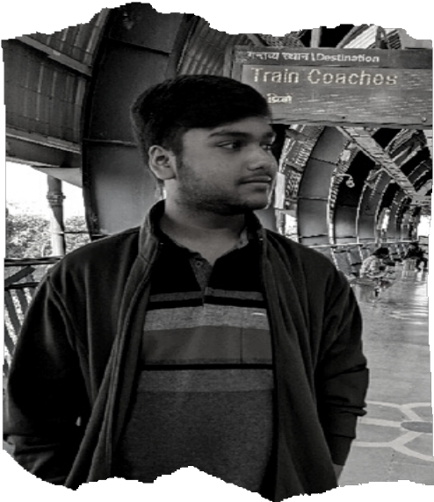
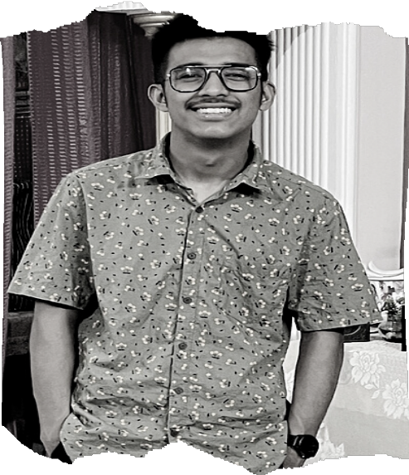
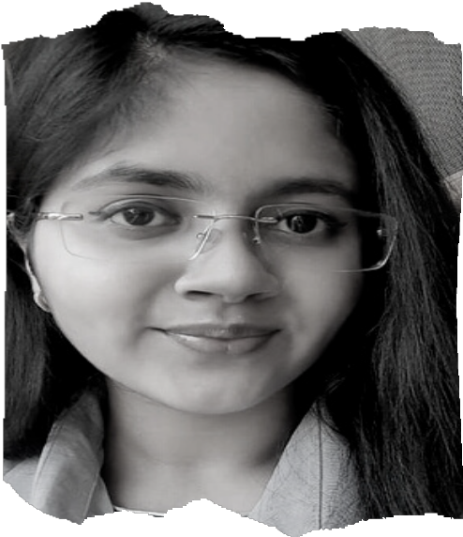
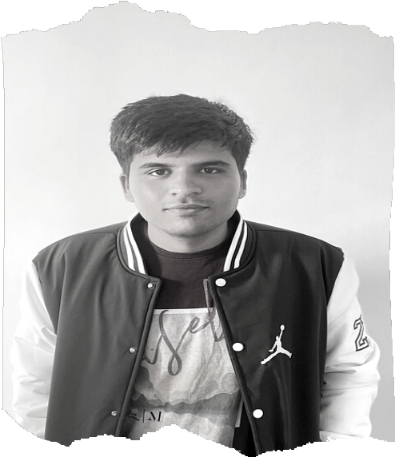
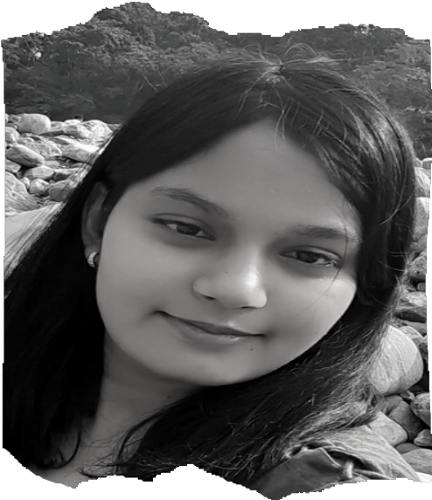
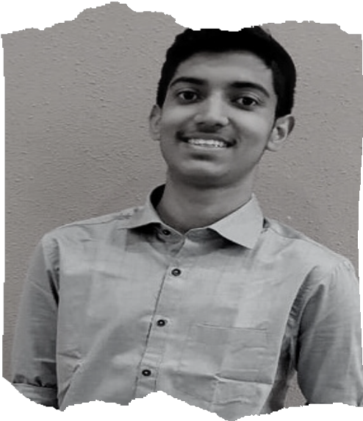


INDIVIDUAL CONTRIBUTION
CHIRAG
LOGIC BUILDER
AKSHAY
DEBUGGER
ADITI
DOCUMENTATOR
AMAN
UI DESIGNER
SHIVANGI
UI DESIGNER
DEVESH
SQLITE OPERATOR

Slide 6




APPLICATIONS
1
ACCEPTS AND SAVES USERS' DATA.
2
PROVIDES REQUIRED INFORMATION OF ALL THE AVAILABLE MEDICINES.
3
CREATES AND SAVES MEDICAL HISTORY OF USER FOR BETTER ANALYSIS.
4
PROVIDES AN ORGANISED INTERFACE TO PROMOTE A USER- FRIENDLY SPACE.

Slide 7
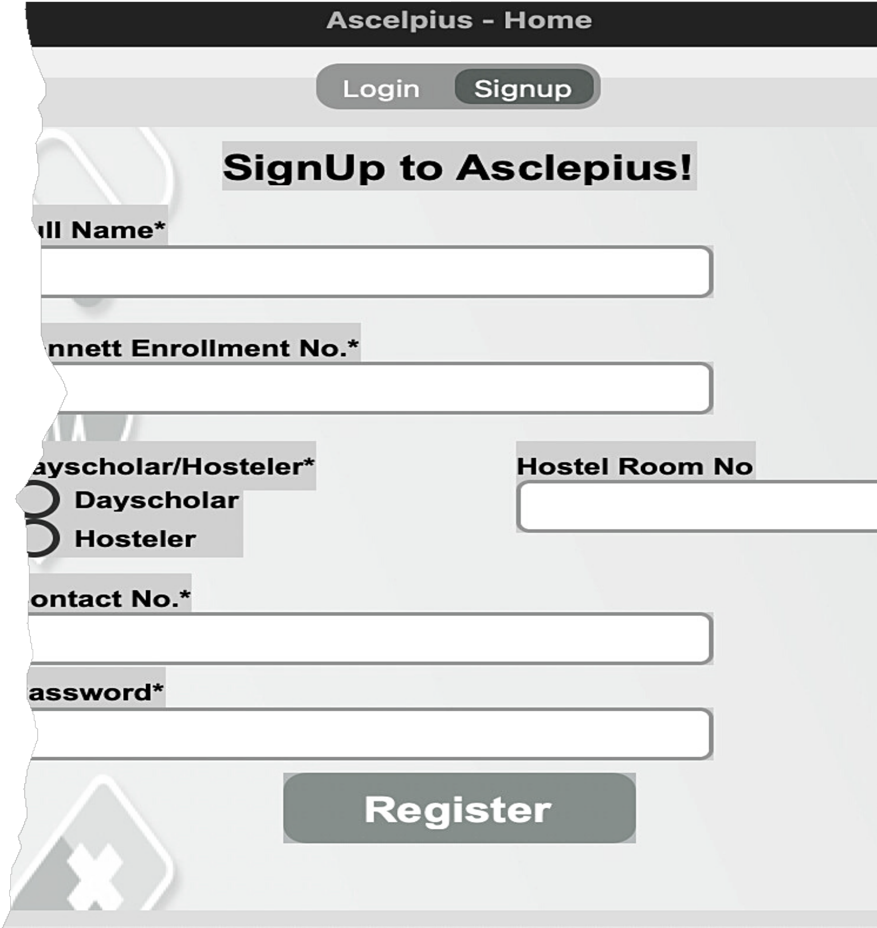

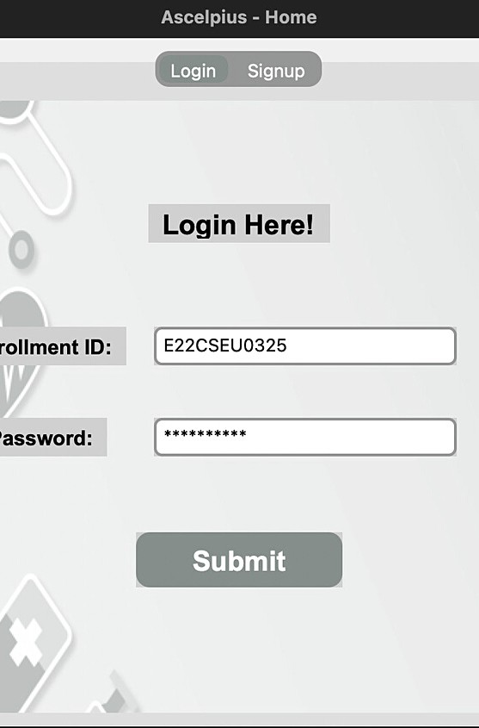
REFERENCES
Tom Schimansky
FOR CUSTOMTKINTER
www.1mg.com
FOR DATA VERIFICATION

Slide 8
Thanks For Watching
- T E A M O B S I D I A N -

